Slide 1
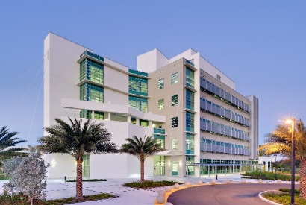
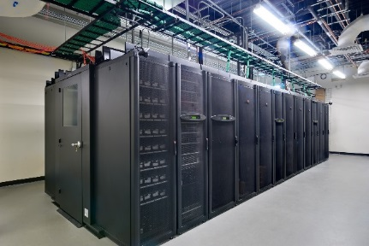
Lecture 1 Functions and Characteristics of
Operating Systems
Borko Furht
Florida Atlantic University

Slide 2
Objective
A good teacher knows how to teach, a better teacher knows how to explain, and the best teacher inspires students.
Objective: to be the best teacher.

Slide 3
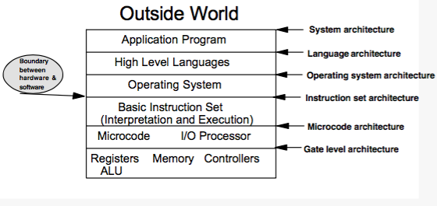
Computer Architecture
An architecture is the boundary of interface between two of functional modules

Slide 4
Operating System Big Picture
CPU
Memory
Disk
I/O
Process Management
Memory Management
I/O Management
Process
synchronization
Create
Process
Memory
allocation
Disk
scheduling
Fetching
algorithm
File
System
PMT
Process
Scheduling
Deadlock
resolution
Device
drivers
PCB
Page placement &
replacement
Program execution
Program
designer
System Calls
4.
5.
Information maintenance:
get/set time, system data
1.
2.
3.
Process control: create, load, execute, semaphores
File manipulation: create, delete, open, read
Device manipulation: request, release, read, write
Communications: send, receive

Slide 5
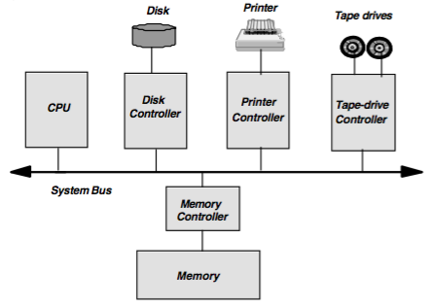
Modern Computer System

Slide 6
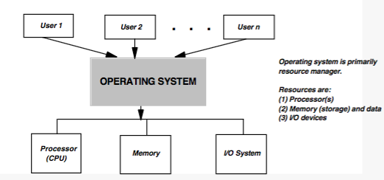
Operating System Definition
Operating system are programs implemented in software that make hardware useful.

Slide 7
Operating System is a Resource Manager
Defines the user interface
Shares the hardware among users
Allows users to share data among themselves
Performs scheduling resources among users
Handles I/O operations
Manages protection and error handling

Slide 8
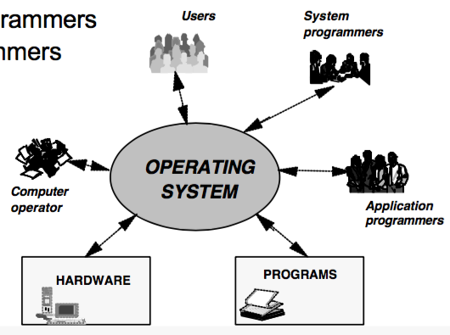
Operating System and its Interfaces
Computer operators
Application programmers
System programmers
Programs
Hardware
Users

Slide 9
Types of Operating Systems
Single user, single program systems
Single user, multitasking systems
Time-sharing multiuser system
Parallel systems
Distributed systems
Real-time systems

Slide 10


Single User Systems
One user at a time – one task at a time.
Example: MS-DOS
Multitasking systems: several jobs are kept in the memory at one time
The CPU is switched among the jobs to increase CPU utilization and decrease the total execution time.
Examples: OS/2, Windows 95, Windows NT

Slide 11

Time-Sharing Multiuser Systems
Extension of multiprogramming systems.
Allow many users to use a computer system interactively at the same time.
Examples: UNIX, VMS

Slide 12
Parallel Systems
Multiprocessor systems with multiple CPUs
Goals: increase the throughput and computational performance
Symmetric multiprocessor model: each processor runs an identical copy of OS. (Example: Encore’s Multimax)
Asymmetric multiprocessor model: a master processor controls the system and runs OS. The other processors execute assigned tasks (master-slave)

Slide 13
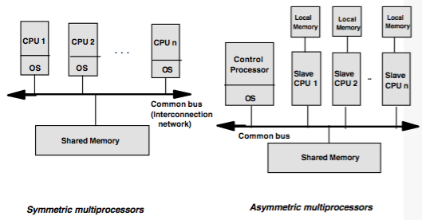
Parallel Systems – Block Diagrams

Slide 14
Distributed Systems
Multiple processors are not tightly coupled (like in parallel systems) – they do not share memory and clock.
Each processor has its own local memory.
They communicate via high-speed buses or telephone lines (loosely-coupled systems).
The reasons for distributed systems: resource sharing, computation speedup, reliability, communication.

Slide 15
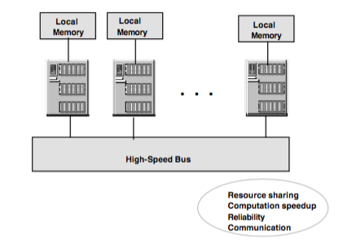
Distributed Systems – Block Diagram

Slide 16
Real-Time Systems
Special-purpose operating systems
Rigid time requirements on the operation of a processor
For time-critical applications (industrial, embedded systems, etc.)
Hard real-time systems – all tasks should be completed within the deadline
Soft real-time systems – critical tasks have priority over other tasks.
Examples: RT Unix, LynxOS, VRTX, OS-9

Slide 17
OS System Components
Process Management
Main Memory Management
I/O System Management
File Management
Secondary Storage Management
Networking
Protection System

Slide 18
OS Services
Program execution
I/O operations
File system manipulation
Communications
Error detection
Resource allocation
Protection
Accounting

Slide 19
System Calls
Provide the interface between a process and the OS
Can be grouped in the five major categories:
Process control (create process, load, execute…)
File manipulation (create files, delete, open, read...)
Device manipulation (request device, release, read, write...)
Information maintenance (get/set time or date, get/set system data)
Communications (create/delete communication connection, send/receive messages)

Slide 20
REGISTERS
Storage-device hierarchy
CACHE
MAIN MEMORY
SOLID-STATE DISK
MAGNETIC DISK
OPTICAL DISK
MAGNETIC TAPES

Slide 21
Performance of various levels of storage
Level | 1 | 2 | 3 | 4 | 5
Name | Registers | Cache | Main memory | Solid state disk | Magnetic Disk
Typical Size | < 1KB | < 16MB | < 64GB | < 1TB | < 10TB
Implementation technology | Custom memory with multiple ports CMOS | On-chip or Off-chip CMOS SRAM | CMOS SRAM | Flash memory | Magnetic disk
Access Time (ns) | 0.25-0.5 | 0.5-25 | 80-250 | 25,00-50,000 | 5,000,000
Bandwidth | 20,000-100,000 | 5,000-10,000 | 1,000-5,000 | 500 | 20-150
Managed by | Compiler | Hardware | Operating system | Operating system | Operating system
Backed by | Cache | Main Memory | Disk | Disk | Disk or tape

Slide 22
Migration of Data from Disk to Register
Magnetic
Disk
Main
Memory
Cache
Hardware
Register

